Slide 1

Snowmen in the Square- Shop Local this Holiday Season
A Campaign for the Oxford Lafayette Chamber of Commerce
By: Erin Prince

Slide 2
Oxford Lafayette Chamber of Commerce
For this internship, the Chamber of Commerce had me make graphics for special events, attend a golf classic, and write press releases.
Mission Statement; “Our mission is to undertake programs and projects that improve the quality of life in our area.” Their vision statement is “By seeking a positive business climate conducive to growth of our private enterprise system, raising per capita income and providing strong financial, physical and Human Resources we create a better life for all of our citizens.”
Vision Statement; “By seeking a positive business climate conducive to growth of our private Enterprise system, raising per capita income and providing strong financial physical and Human Resources we create a better life for all of our citizens.”
Main Goal; increase the amount of members to 850 from 750 within the 2024 calendar year and increase the amount of shopper during the holiday season for local businesses.

Slide 3
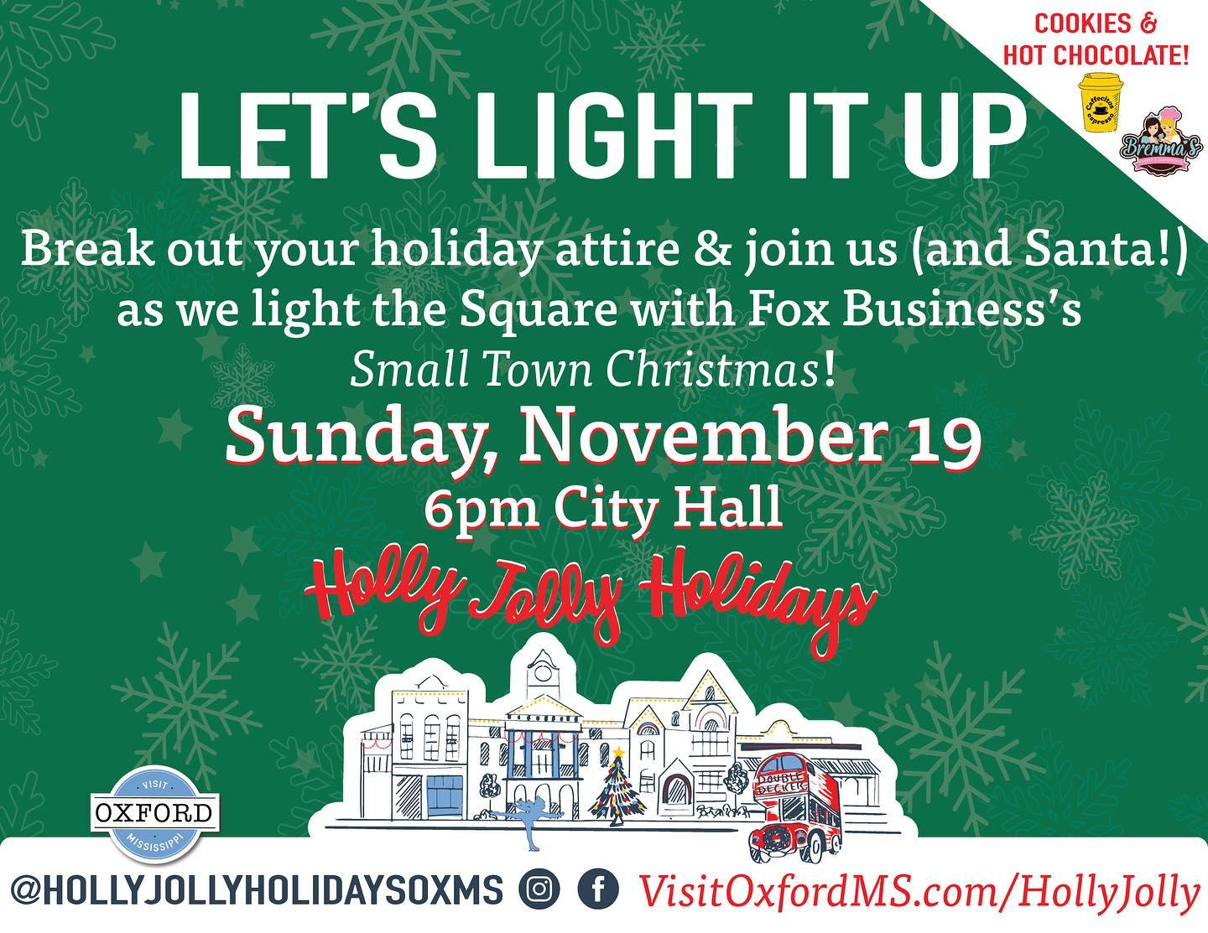
Situation Analysis/Secondary Research
The campaign seeks to increase holiday shopping in the Oxford area and the importance of shopping locally
Auburn Chamber of Commerce, Olive Branch Chamber of Commerce, Crystal Lake Chamber of Commerce, Visit Oxford, and the City of Oxford
Holly Jolly Holidays event (Visit Oxford and the City of Oxford)
Christmas Parade (Olive Branch Chamber of Commerce)

Slide 4
Key Publics/Messages
Oxford Families are the target public
Organization; Expand the knowledge of the Chamber to locals, Make the Chamber the “go to” place for new families in the area, and Bring awareness of the Chamber to businesses to help grow membership.
Topic; Shopping local during the holidays supports the town, Shop Local family oriented events build community involvement, and Supporting small businesses can have a big impact on a town.

Slide 5
SMART Objectives
To increase awareness of local businesses in the Oxford/Lafayette County area 20% by January of 2025.
To reinforce the attitude of importance of shopping locally especially during the holiday season to Oxford locals by 15% by January of 2025.
To change the behavior of Oxford locals about businesses and grow support by 10% by January of 2025.

Slide 6
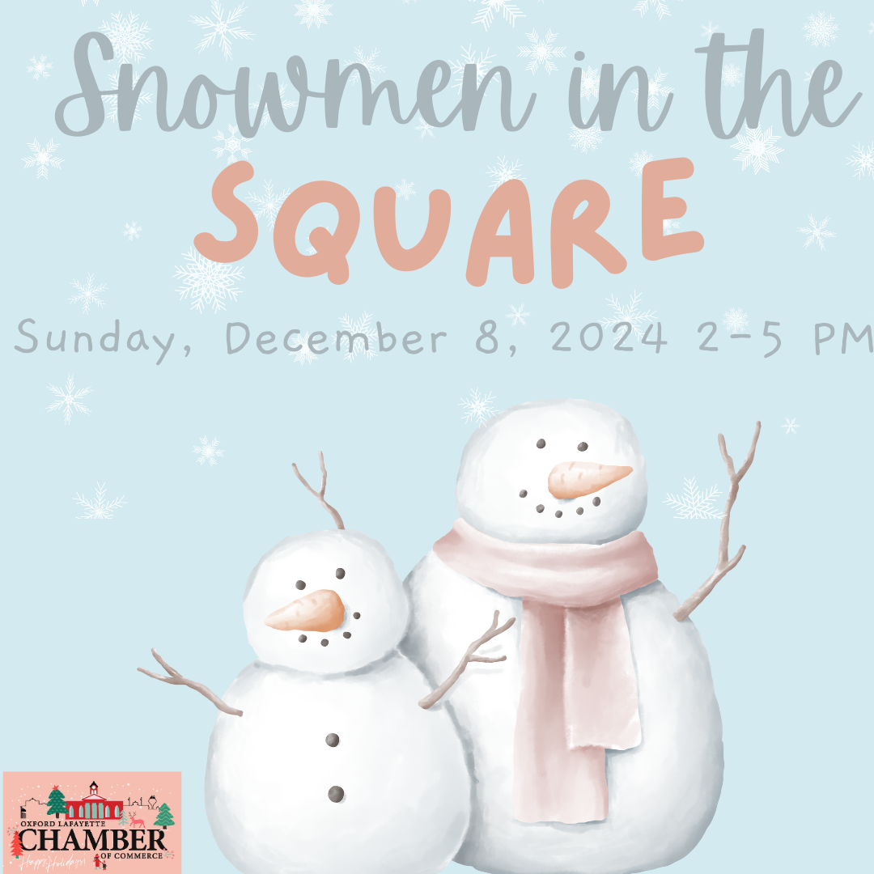
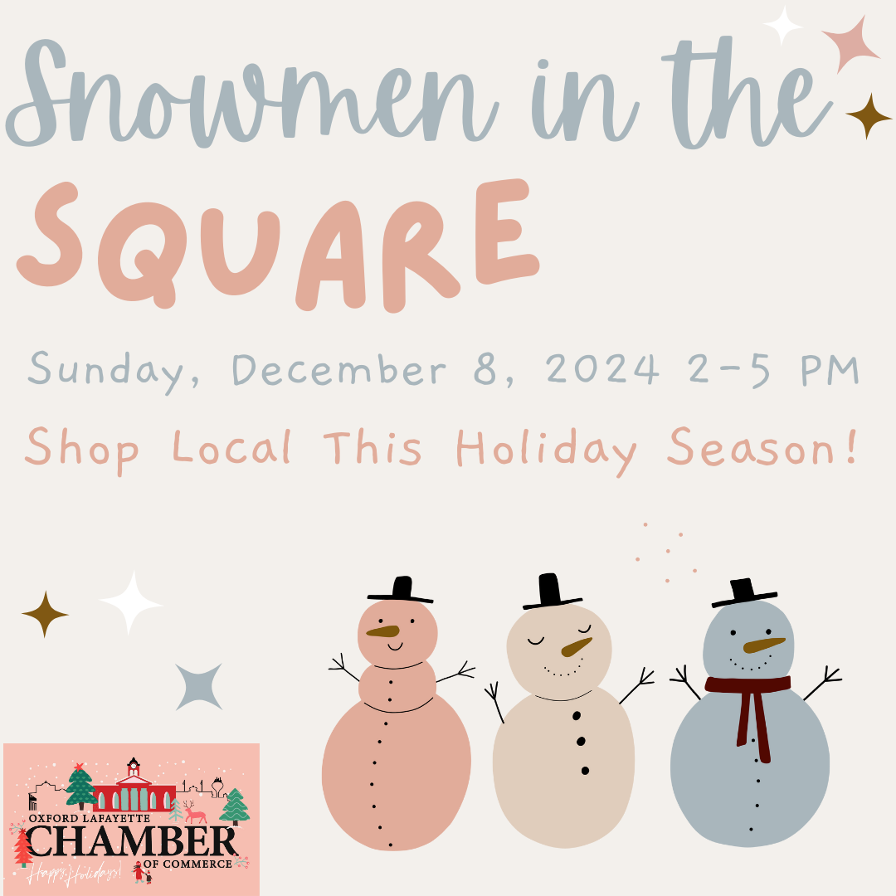
Actions and Communications Tactics
Snowmen in the Square special event and the Social Media Giveaway event
Instagram, Facebook, and X (Twitter) as social media channels
Media Kit
No TikTok but want to use Visit Oxford’s TikTok
“Ever wonder what Snowmen do in the Square? Come to the Chamber of Commerce’s ‘Snowmen in the Square’ event to figure it out!#snowmensquared “

Slide 7

Proposed Budget and Evaluation
Total Cost for whole campaign; $2,068.00
Would like to see how the campaign helps local businesses in Oxford during the holiday season (increase revenue by 20%)
Can be an event that happens year after year for ROI

Slide 8

Wrap-Up
Total Cost for whole campaign; $2,068.00 Campaign would start early November and end on December 29, 2024
Snowmen in the Square event would happen on December 8, 2024
Social Media Giveaway would be on December 12, 2024
Would like to see how the campaign helps local businesses in Oxford during the holiday season (increase revenue by 20%)
Thank you!!

